Slide 2

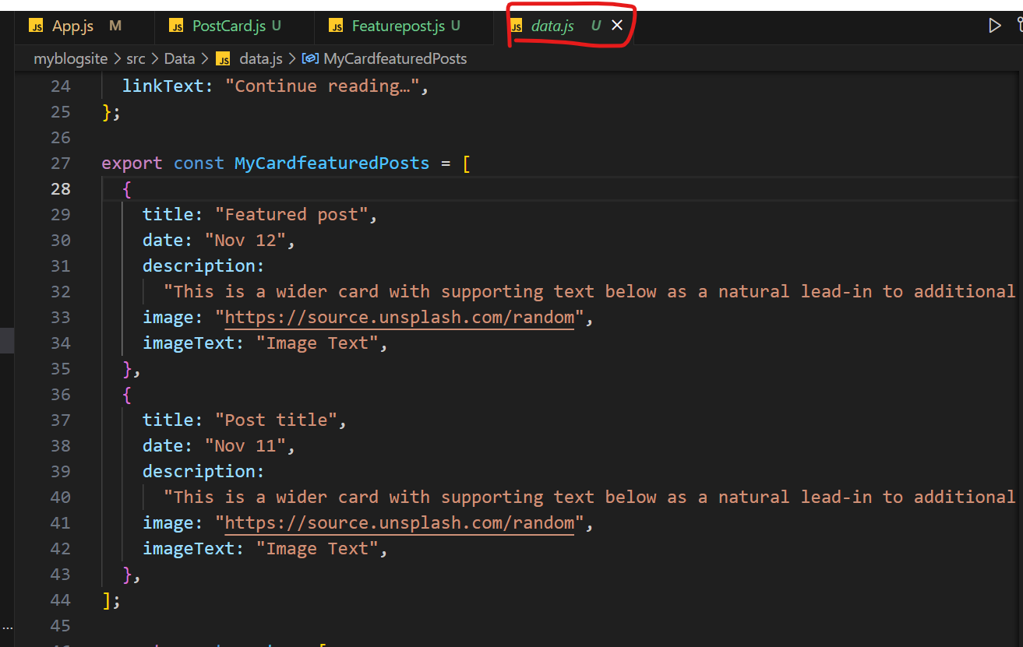
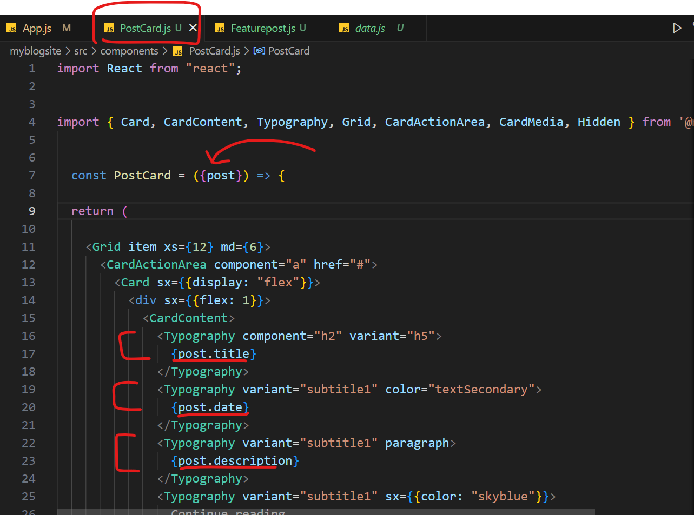
MyCardfeaturedPosts []
App.js
Data.js
PostCard.js

